Slide 1
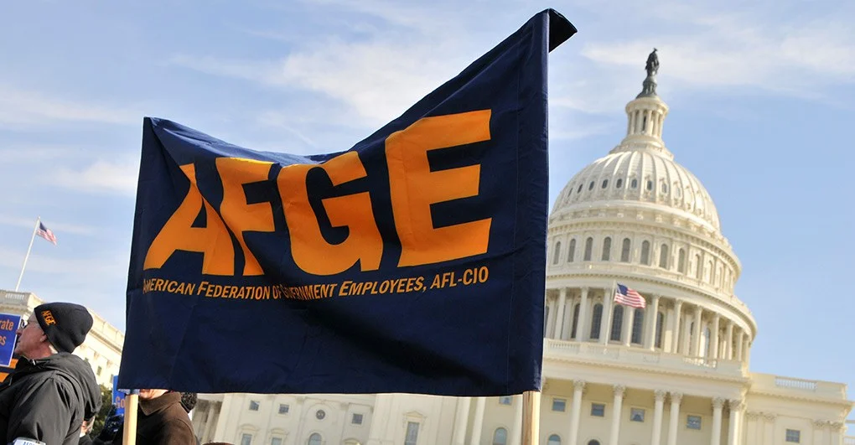
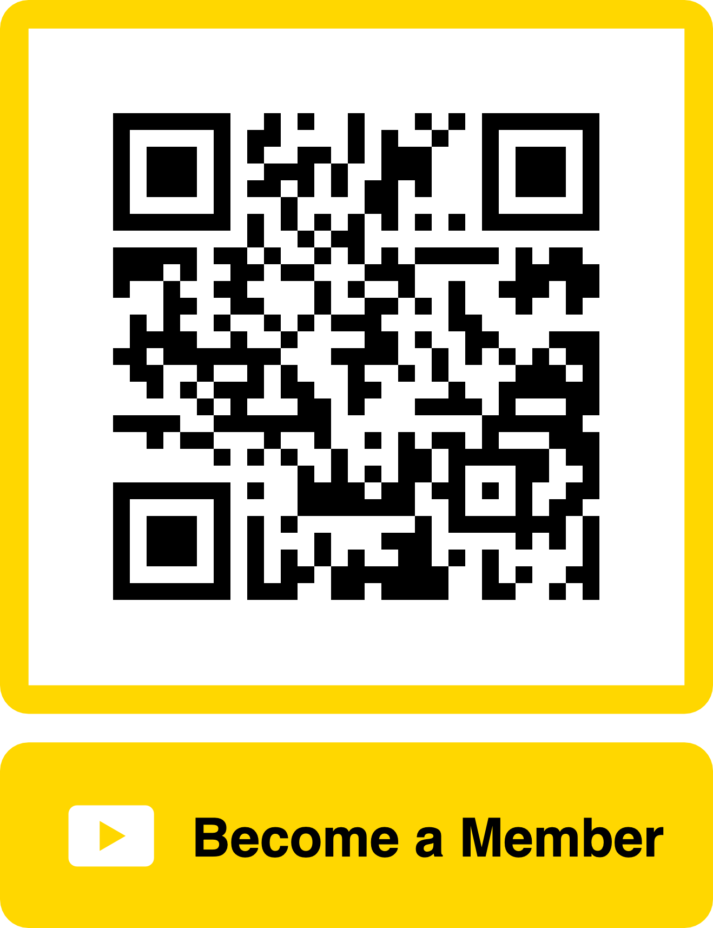
AFGE
LOCAL 1133
Welcome!

Slide 2

WHAT IS A UNION
Organized association of workers formed to protect and further their rights and interests.
Represents both individuals and groups of employees, concerning but not limited to working conditions, grievances, and disciplinary actions.
Through union membership, workers can impact wages, work hours, benefits, workplace health and safety, and other work-related issues.
Unions have brought us minimum wage, social security payments, 8-hour work days, overtime pay, etc.

Slide 3

AFGE OVERVIEW
AFGE: American Federation of Government Employees
Established in 1932.
Largest Federal Union in the Nation with over 750,000 members and just under 1,000 Locals Nationwide.
AFGE represents employees in nearly every Federal Agency including the Department of Veteran Affairs, Social Security Administration, DOD, HUD, USDA, and many more.

Slide 4

AFGE LOCAL 1133 ELIGIBILITY
AFGE Local 1133 is the ONLY Union at the Robley Rex VAMC.
AFGE Local 1133 covers all facilities under the VA Chillicothe Health Care.
AFGE represents almost all professions.
Supervisors cannot receive representation but are eligible to join to take advantage of the benefits.
Union dues are $24.00 Bi-Weekly
New members will receive a $50.00 incentive for joining today.

Slide 5

WHAT WE DO
AFGE Officers, Stewards, and Executive Team are well-trained and educated to ensure you receive the REPRESENTATION you deserve.
AFGE LOBBIES on your behalf to protect your rights and get you better pay, working conditions, benefits, and overall work experience.
AFGE takes seriously the responsibility to help provide the best possible government services while ensuring that Federal Employees are treated fairly and with dignity.
OUR STRENGTH IS IN OUR NUMBERS!

Slide 6
These are Just a Few of Many Reasons to Thank a Union
Historically…
Weekends without work
40-hour workweek
Pensions
Child Labor Laws
Paid vacation
Family & Medical Leave Act (FMLA)
Collective Bargaining
Overtime Pay
And much more….
More Recently…
National Average Annual Pay Raise of 5.2% in 2024.
Currently Fighting for a 7.4% Pay Raise for 2025.
12 Weeks of Paid Annual Parental Leave.
Successfully fought off moving Federal Retirement calculations from high 3 to high 5.
Successfully fought off proposals to increase employees’ share of health care premiums.
And much more….

Slide 7
Know Your Rights At Work
By law, you have the right to form, join, and assist any labor organization (Statute: 7102 & 7114). That means:
You have the right to join AFGE
Employees covered by the Statute have a protected right to form, join, or assist AFGE. You also have the right to refrain from such activity.
You have the right to be active in AFGE
You have the right to be a representative and, in that capacity, present the views of AFGE to heads of agencies, the Executive branch of the government, Congress, and more.
You have the right to collectively bargain through AFGE
Along with fellow employees, you have the right to negotiate your telework, leave, childcare, and other working conditions through representatives you choose.

Slide 8
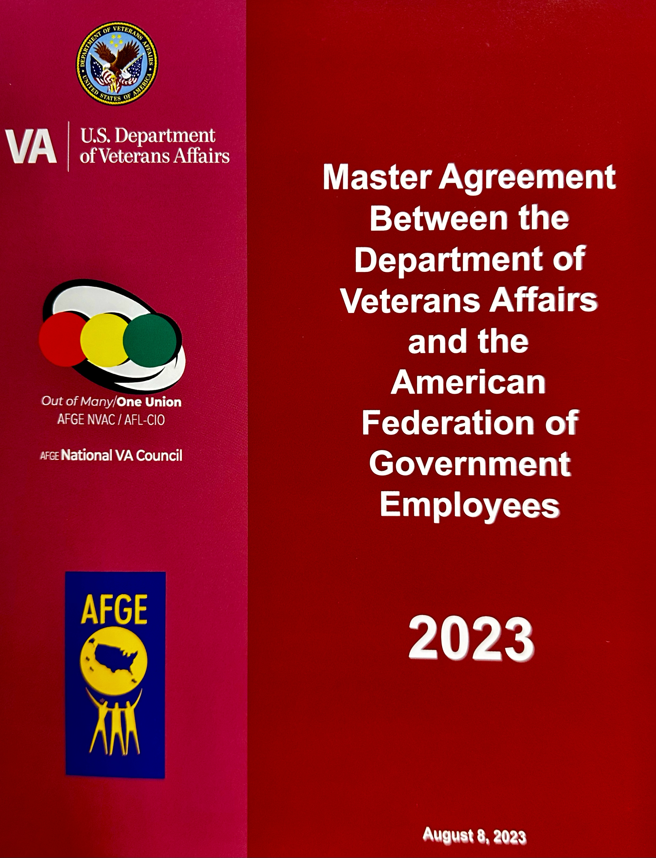


HOW DO WE ACHIEVE THIS?
AFGE/DVA Master Greement
The Agency Must Honor The Master Agreement
We Represent and Enforce This Agreement
We Ensure That The Agency Does Not Violate Your LEGAL Rights

Slide 9


Slide 10


AMERICAN FEDERATION OF
GOVERNMENT EMPLOYEES
UNION BENEFIT ORGANIZER
Presented by: Yafa Osona
Email: Yosona@Benefitarchitects.com
CELL: 513 562 - 0262
Please sign in by scanning the QR Code with your mobile device and entering your contact information.

Slide 11
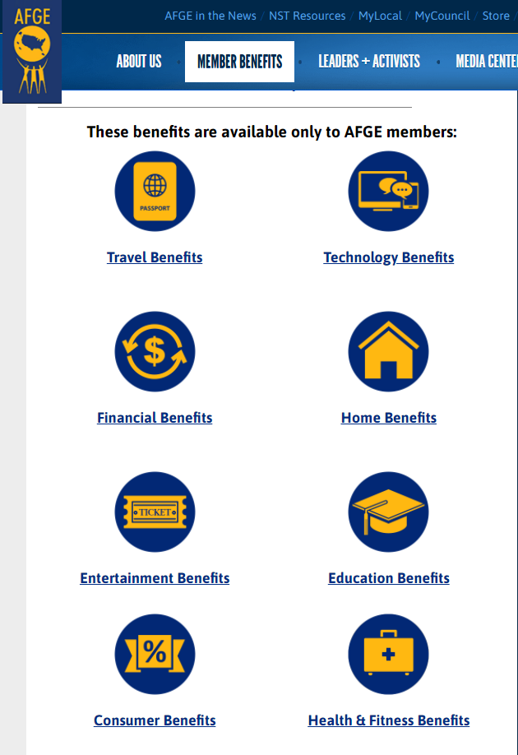
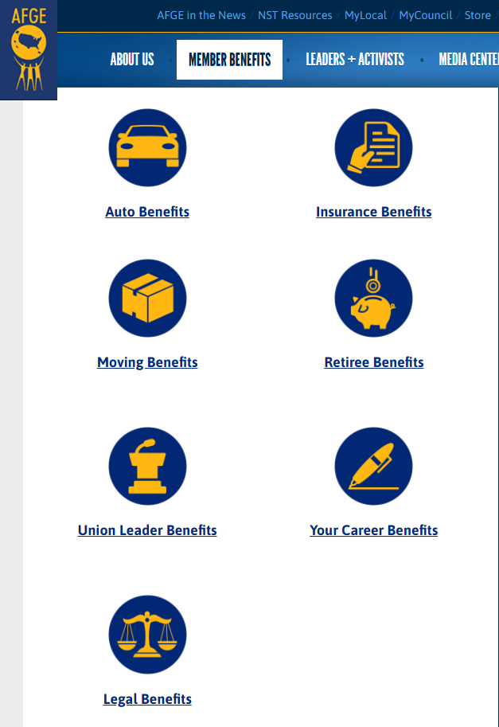

AFGE
BENEFITS
YOU AND
YOUR FAMILY
CAN ENJOY!
AFGE.ORG

Slide 12
Government Insurance Options
Health Insurance
Dental/Vision Insurance
Short-Term Disability Insurance
Life Insurance
😀 😐 😶 😱
Great Plans!
Okay
Not offered!
What is it?

Slide 13
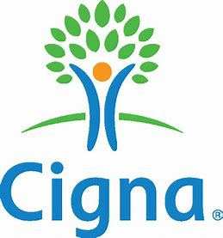
UNION DENTAL PROGRAMS
THE HIGHLIGHTS:
Two PPO and two DHMO plans are offered.
NO Annual Max Benefit (DHMO).
NO Waiting Periods.
Implant Benefits offered.
Dependents covered to age 26.
Extended family eligible for their own plans.
Coverage is Portable.
Open enrollment year-round.

Slide 14
UNION DENTAL PROGRAMS COMPARISON
BI-WEEKLY PREMIUM | UNION HIGH DHMO | UNION STANDARD DHMO | FEDVIP AVERAGE HIGH OPTION | ANNUAL SAVINGS WHEN CHOOSING UNION STANDARD DHMO
JUST SELF | $18 | $8 | $22 | $364 ANNUAL SAVINGS
SELF + 1 | $31 | $13 | $46 | $858 ANNUAL SAVINGS
FAMILY | $49 | $18 | $68 | $1,300 ANNUAL SAVINGS
AVERAGE OUT-OF-POCKET COST
CROWN (Molar: Porcelain with High Noble) | $50 | $450 | $650 | $200 IN SAVINGS
ROOT CANAL (MOLAR) | $75 | $335 | $600 | $265 IN SAVINGS
      ** By choosing Cigna Standard DHMO instead of the Federal High option, you can save up to $1,300 on dental premiums, making your dues free and putting $700 - $800 back in your paycheck.

Slide 15
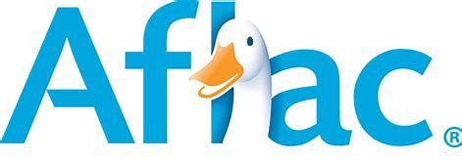
AFLAC SHORT-TERM DISABILITY
Fills a BIG Gap in the Federal Benefits: Federal employees do NOT have Short-Term Disability benefits and are NOT eligible for State Disability Benefits.
Protects Your Most Important Asset: The ability to Earn an Income.
Monthly Benefits: Provides up to 60% of gross monthly income as a tax-free benefit. The maximum monthly benefit amount is $6,000.
What’s Covered: Off-Job accidents, sickness, surgeries, and even maternity
What about Leave: You can use your Aflac Disability with your Leave. Or save your leave and only use the disability insurance.
NOT One Size Fits All: When enrolling, your Benefit Architect Benefit Organizer will help you select the right benefit amount, waiting periods, and benefit periods. It’s tailor-made for each member.
All Members Qualify: NO HEALTH QUESTIONS ASKED.
Other BIG Advantages:
Significantly Better Benefits and Lower Premiums when compared to other outside options and outside Aflac plans.
Portable

Slide 16
ADDITIONAL PLANS OFFERED
HOSPITAL INDEMNITY: Provides Cash Benefits for hospital confinement, hospital admission, hospital intensive care, Doctor visits, inpatient surgery and anesthesia, outpatient surgery, and more.
ACCIDENT: Provides More than 50 Cash Benefits for on and off-the-job accidents: Fractures, dislocations, wellness benefits every 12 months for each individual enrolled starting after the first year of coverage, and much more
CRITICAL ILLNESS: Pays Cash Benefits when diagnosed with a covered critical illness. Select up to a $30,000 benefit amount to be paid out as a lump sum when diagnosed. Pays a benefit for cancer, heart attack, stroke, and more.
VISION: $5 Self, $10 Self + 1, and $14 Entire Family. An eye exam is a $10 copay, and lenses for glasses are $15. It provides $130 towards your frames and a 20% discount for any amount above $130. It also provides $130 towards the cost of contacts and a 15% discount for any amount above $130.
Other BIG Advantages:
One claim for all Aflac benefits.
Claims paid as Direct Deposit
Plans work together

Slide 17

FEGLI Rates not guaranteed and subject to change; Rate Information for the calculations provided by the OPM website (www.opm.gov). Rates current as of 1/1/2024.

Slide 18
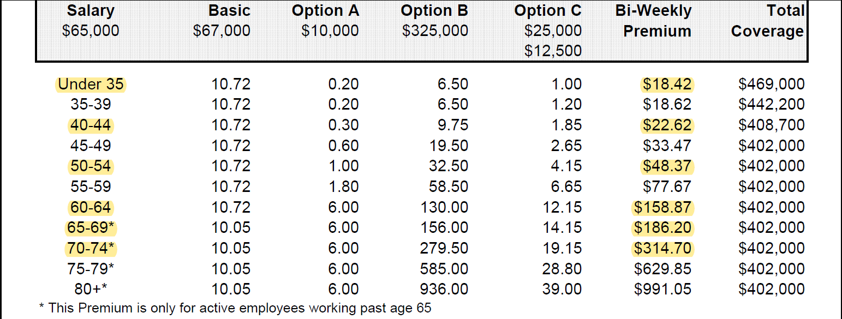
FEGLI Bi-Weekly Cost Analysis Example
Active at Work
FEGLI Rates are not guaranteed and subject to change; the OPM website provides Rate Information for the calculations (www.opm.gov). Rates are current as of 1/1/24.

Slide 19
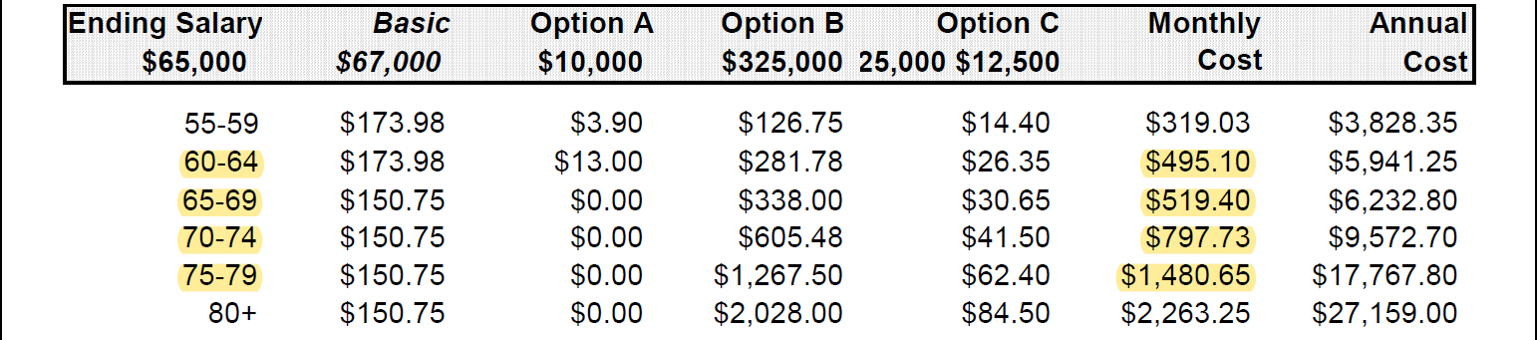
Monthly Coverage and Cost Analysis RETIREE
Cost for No Reduction of Basic, Option B & Option C
FEGLI Rates not guaranteed and subject to change; Rate Information for the calculations provided by the OPM website (www.opm.gov). Rates current as of 1/1/24.

Slide 20


UNION MEMBER LIFE
Other BIG Advantages:
Dependents & Extended family are eligible for coverage.
Open enrollment year-round.
NO Health Questions Asked Option with Allstate.
Level Premiums: Designed to NOT increase cost until age 121.
Earns Tax-Deferred Cash Value: A portion of the premium that goes into a cash value account and earns interest. The Cash Value can be accessed in the future for emergencies, supplement retirement, pay premiums, or even cashed out.
Portable: Take it with you if you ever leave your job. You receive a policy.
Living Benefits: You don’t have to die to access the death benefit. Living Benefits give you access to the death benefit for Critical, Chronic (long-term care needs), and Terminal illnesses.
Comparison: 35-year-old Member enrolling in and keeping $250,000 in coverage to age 75:
  FEGLI:
    Accumulated Premium: $99,090
    Average Bi-weekly Premium: $95
    Projected Cash Value of $0
  Union Member Life:
    Accumulated Premium: $52,000
    Average Bi-weekly Premium: $50
    Projected Cash Value of $110,754

Slide 21


AFGE RETIREMENT DIVISION
One-on-One meetings:
  Transfers:
    Help avoid the common pitfalls and mistakes employees make when preparing to retire.
    Help with retirement paperwork.
  New to Federal Government:
    Answer questions and assist employees with handling 401K and 403B from their previous employer.
← Schedule your appointment

Slide 22

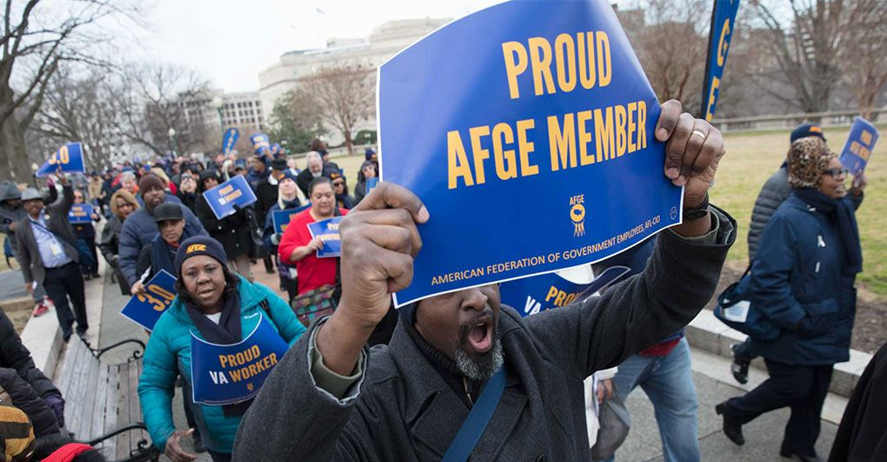
Sign Up Today!
Sign-On Bonus
Sign up today and receive $50.00

Slide 23


HOW TO BECOME A MEMBER!
Scan the QR Code or go to join.afge.org/l1133

Slide 24


Sign Up For Our
Website!
As a member, you will have access to our local website where you can:
Live Chat
Schedule Appointments
File Grievance Requests
Community Forum
Follow Upcoming Events
afge1133.org

Slide 25


How to Contact Us
AFGE Local 1133
Benefits Organizer
Yafa Osona
Union Benefit Organizer
513 562 - 0262
Yosona@benefitarchitects.com
Phone: (502) 439-4776
E-mail: afge1133@gmail.com
Website: www.afge1133.org
Address:
Mellwood Art Center:
1860 Mellwood Avenue Louisville, KY 40206

Slide 26


